Slide 1
ASP.NET MVC
Lesson 8 Sessions & Migrations

Slide 2
Sessions & Migrations
HttpContext (Sessions)
Read
Write
Migrations
Shopping Cart (Business Logic)

Slide 3
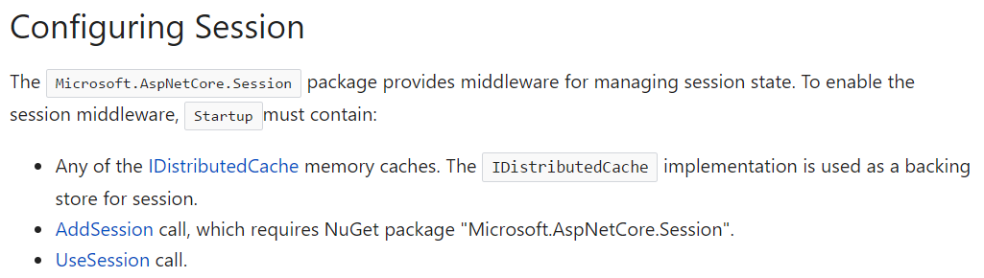
Configuration

Slide 4
Ditributed Memory Cache
When caching, the app loads data that does not change frequently not from the original data source but from cached in memory data
2 types of caching interfaces
IMemoryCache
Cache store in the memory of a specific web server
Only possible with sticky sessions (successive client requests always have to pass through the same web server)
IDistributedMemoryCache
Cache store managed by an external process; spread across web servers
Can also be used for non-sticky sessions
Notes:
When your website is served by only 1 web server, for each pair, a session object is created and remains in the memory of the web server.
All the requests from the client go to this web server and update this session object.
If some data needs to be stored in the session object over the period of interaction, it is stored in this session object and stays there as long as the session exists.
However, if your website is served by multiple web servers which sit behind a load balancer, the load balancer decides which actual (physical) web-server should each request go to.
For example, if there are 3 webservers A, B and C behind the load balancer, it is possible that
www.mywebsite.com/index.cshtml is served from server A,
www.mywebsite.com/login.cshtml is served from server B
and www.mywebsite.com/accoutdetails.cshtml are served from server C.
Now, if the requests are being served from (physically) 3 different servers, each server has created a session object for you and because these session objects sit on 3 independent boxes, there's no direct way of one knowing what is there in the session object of the other. In order to synchronize between these server sessions, you may have to write/read the session data into a layer which is common to all - like a DB. Now writing and reading data to/from a db for this use-case may not be a good idea. Now, here comes the role of sticky-session. If the load balancer is instructed to use sticky sessions, all of your interactions will happen with the same physical server, even though other servers are present. Thus, your session object will be the same throughout your entire interaction with this website.
To summarize, In case of Sticky Sessions, all your requests will be directed to the same physical web server while in case of a non-sticky loadbalancer may choose any webserver to serve your requests.

Slide 5
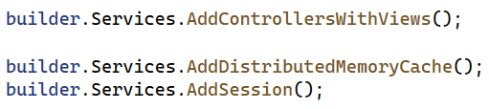
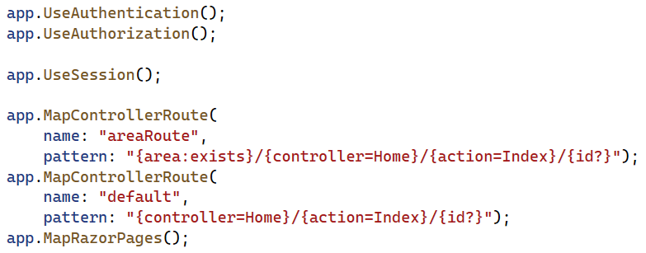
program.cs

Slide 6
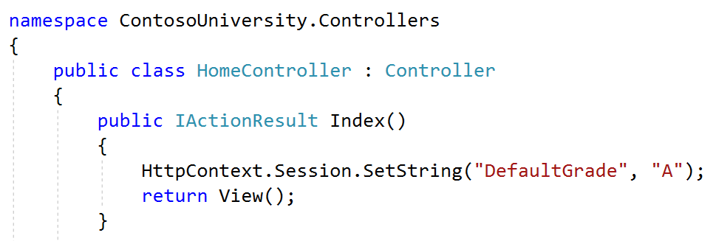
HomeController.cs

Slide 7
EnrollmentsController.Cs
public IActionResult Create()
{
ViewData["CourseID"] = new SelectList(_context.Courses, "CourseID", "Title");
ViewData["StudentID"] = new SelectList(_context.Students, "ID", "Name");
ViewData["DefaultGrade"] = HttpContext.Session.GetString("DefaultGrade");
return View();
}
// also for POST

Slide 8
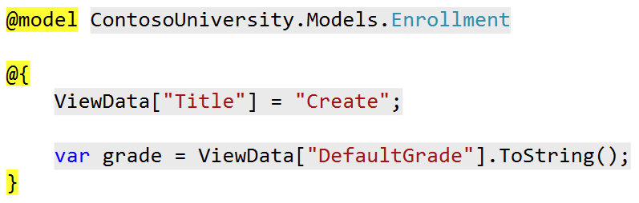
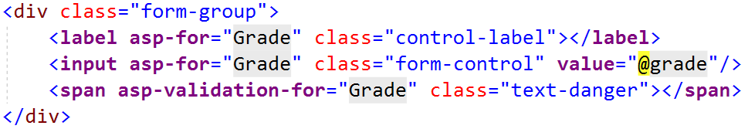
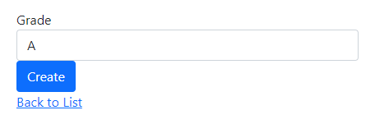
Create.cshtml

Slide 9
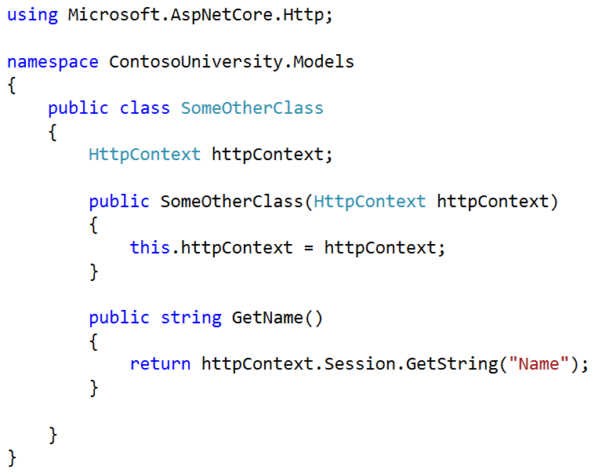
using HttpContext In a Class
HttpContext can only be reached in controllers
Pass as a parameter to classes (Dependency Injection)

Slide 10
Migrations
Modifications to the database with migration scripts without deleting and recreating the database, i.e. without loss of data
Additional properties for models (students e-mail address)
Extra models (Teacher and Classroom classes)
Less properties for models
…
Generate migration scripts from the DBContext and Models
add-migration naam -context DBContext

Slide 11
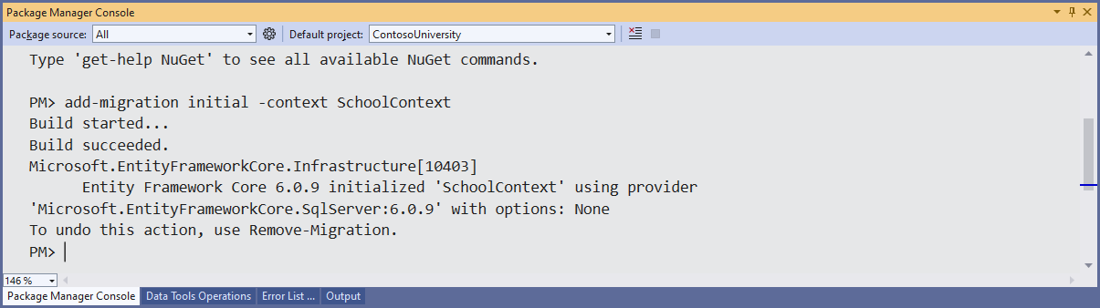
Initial Migration
Tools | Nuget Package Manager |Package Manager Console
add-migration initial -context SchoolContext

Slide 12
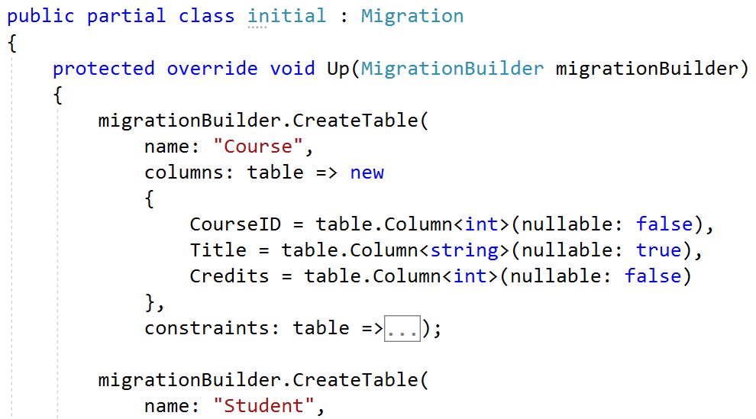
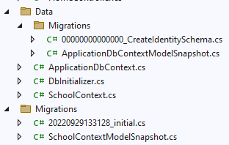
Initial Migration

Slide 13
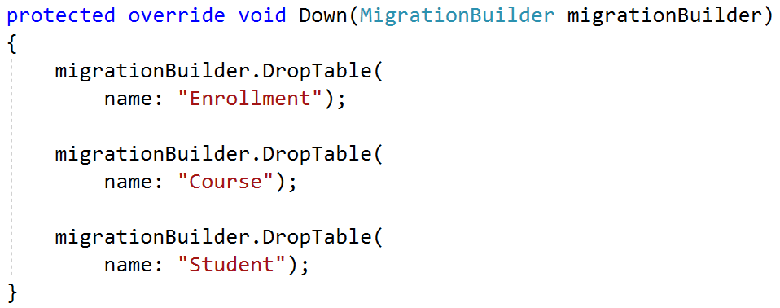
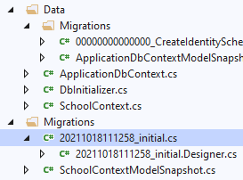
Initial Migration

Slide 14
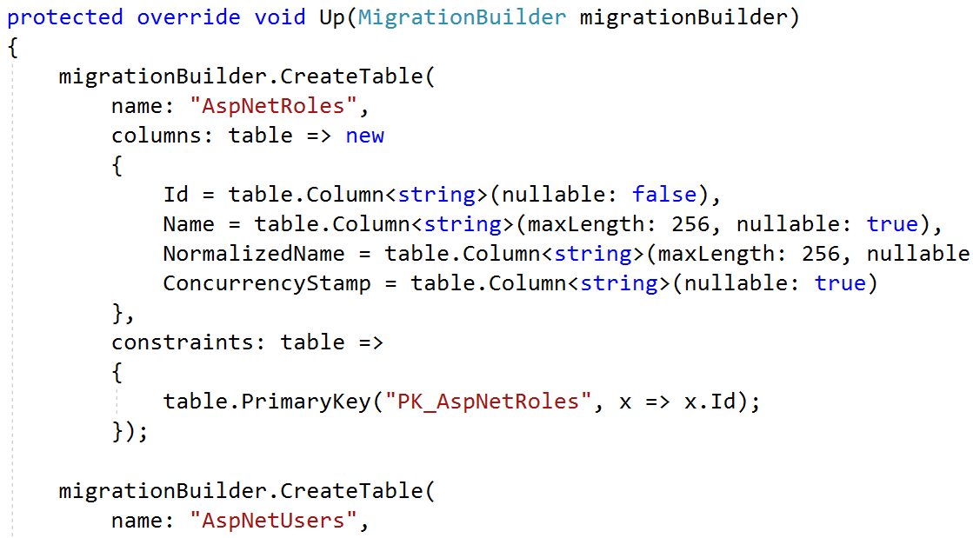
Create Identity Migration

Slide 15
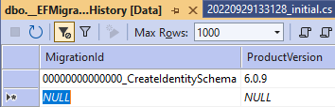
Migrations History
Table EFMigrationsHistory in the database
History of the migration scripts already executed
Only Create Identity Migration
Initial tables (Student, Course, ...) were created without using a migration script

Slide 16
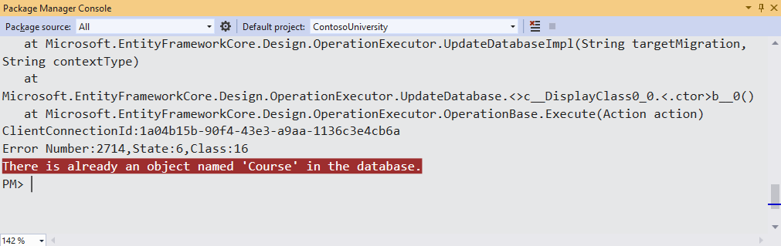
Update-database
Execution of all "open" migration scripts
update-database -context SchoolContext

Slide 17
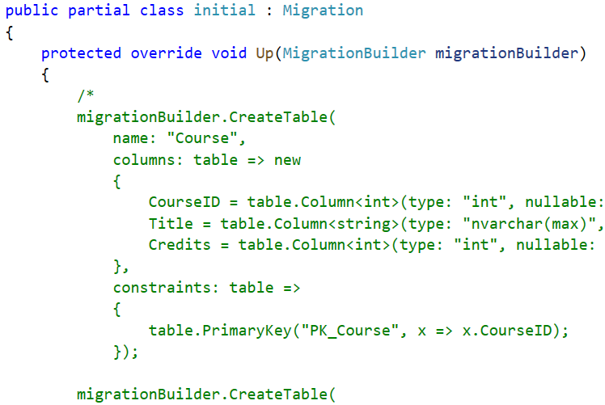
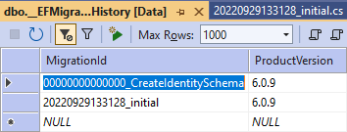
Update-Database
Comment the Up-method before running the update-database statement
Student, Course, … tables already exist in our database
update-database -context SchoolContext

Slide 18
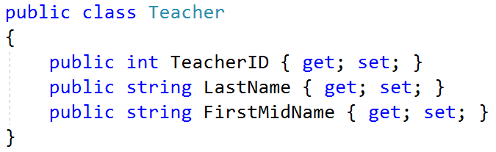
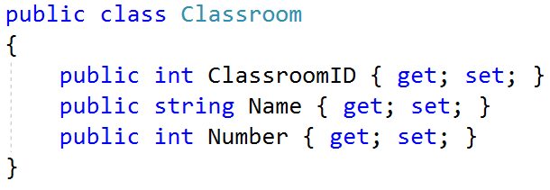
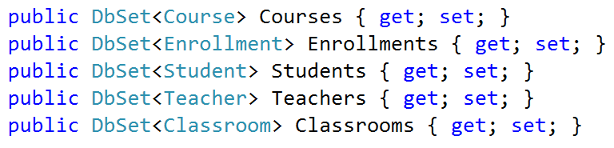
Extra Models
Add the Models
Teacher.cs
Classroom.cs
Modify Data/SchoolContext.cs

Slide 19
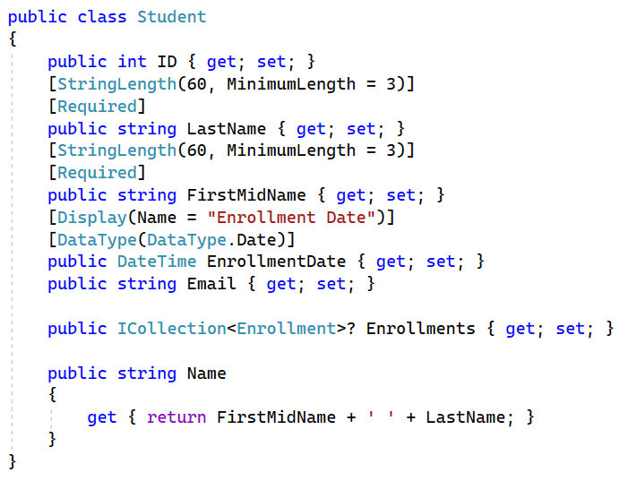
Modifications to Models
Modify Student.cs
Save All
REBUILD

Slide 20
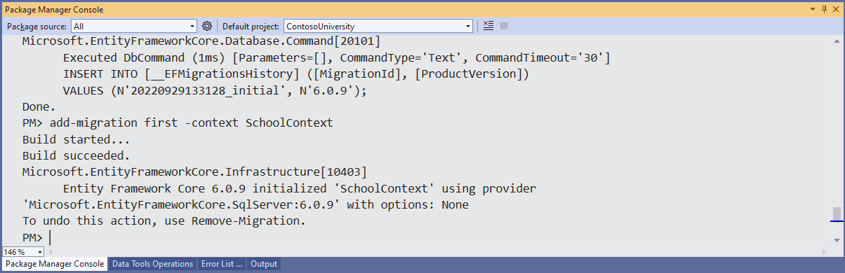
First Migration
add-migration first -context SchoolContext

Slide 21
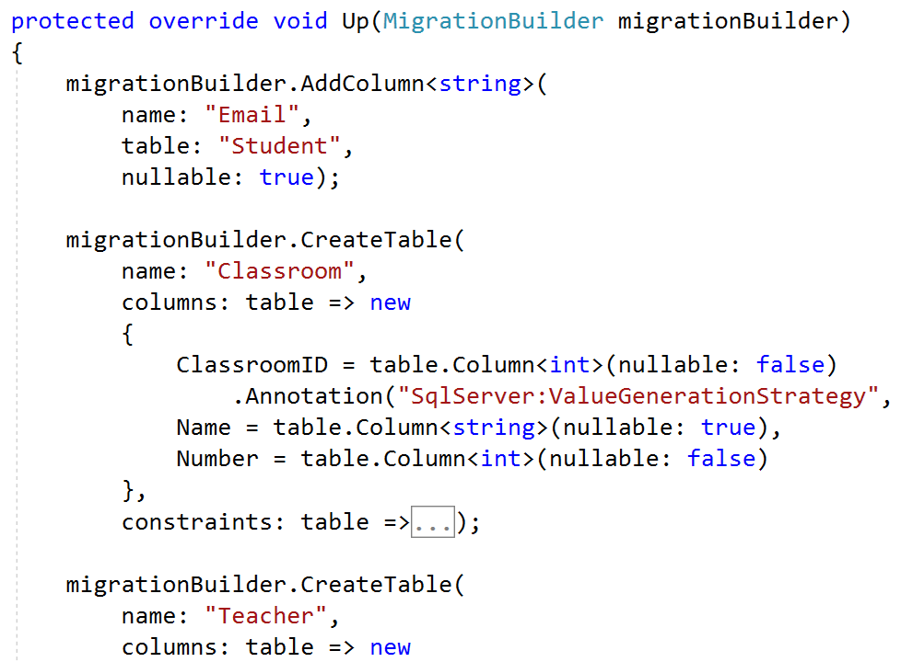

First migration

Slide 22
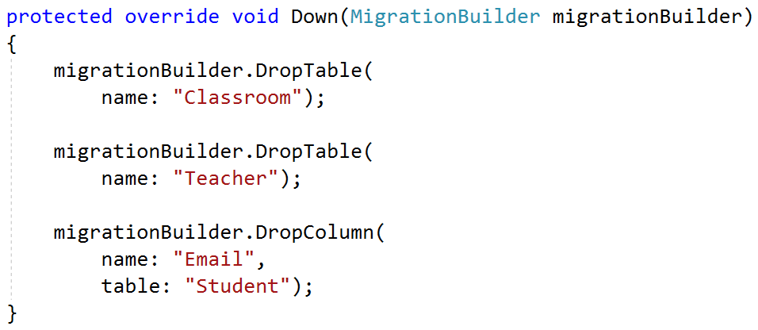
First migration

Slide 23
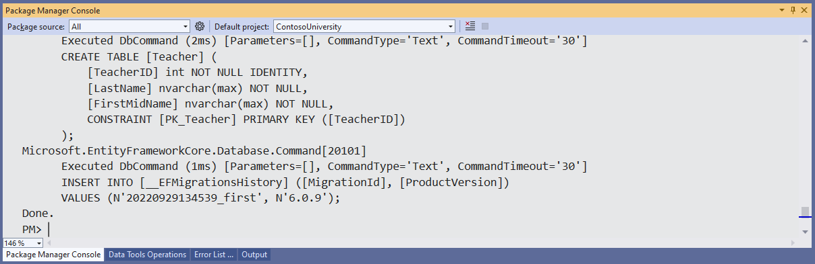
First Migration
update-database -context SchoolContext

Slide 24
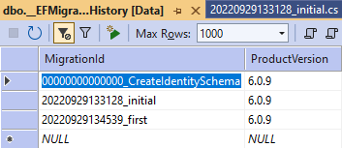
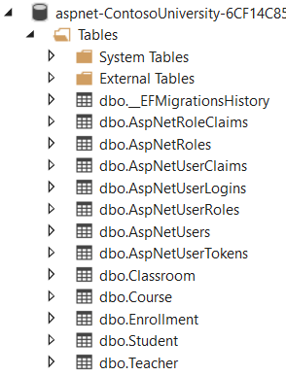
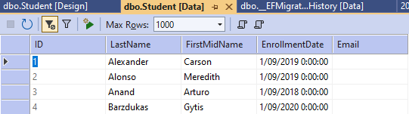
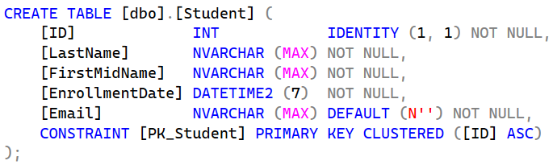
First Migration

Slide 25
a Shopping Cart for our Music Store
Session variable
1ste possibility:
The entire cart in the session variable
2de possibility:
All data from the cart in a table in the database (with a unique key)
Only the unique key as a session variable

Slide 26
Extra Models for the Music Store
To be carried out during the exercise
First set migrations correctly
From resources/Models
CartItem.cs - one product in the shopping cart (before checkout)
OrderItem.cs - one ordered product (copy of CartItem after checkout)
Order.cs - one Order containing multiple OrderItems (after checkout)
From resources/Data
StoreContext.cs

Slide 27
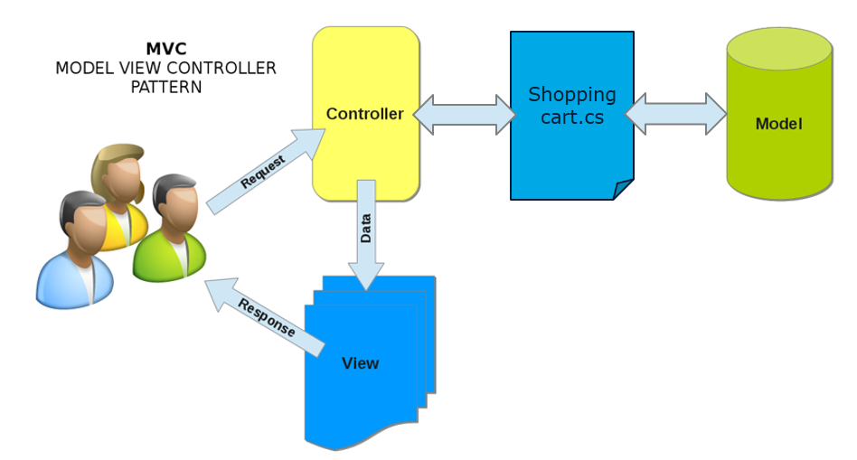
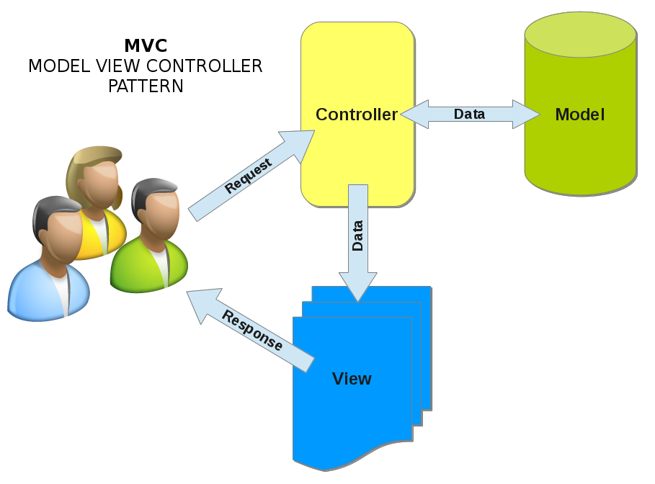
Resources/Models/Shoppingcart.cs (Business Logic)
Extra Business Logic?
Business Logic

Slide 28
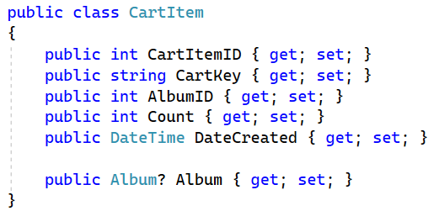
Models (before checkout)
CartKey is the unique value (GUID) written as session variable
DateCreated is the date the product was placed in the cart. Carts that have not been paid for can be emptied using this date

Slide 29
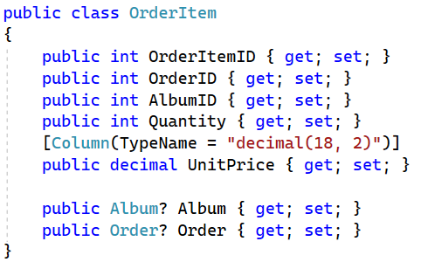
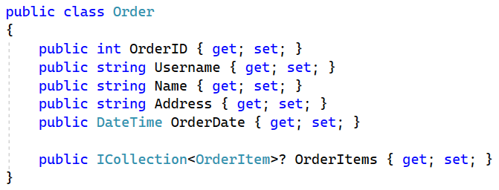
Models (AFTER checkout)

Slide 30
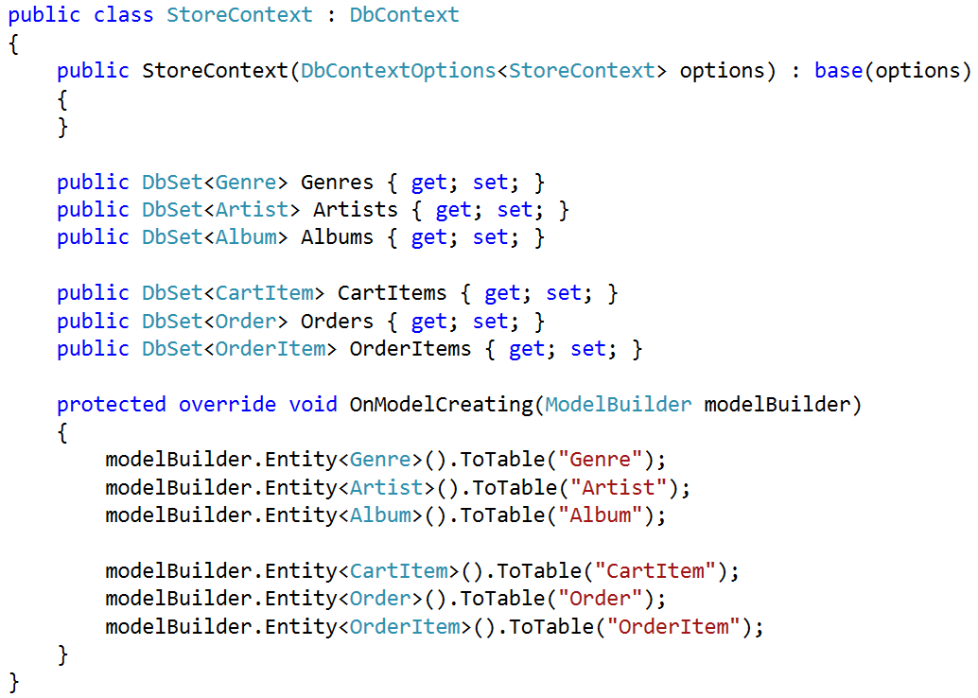
StoreContext

Slide 31
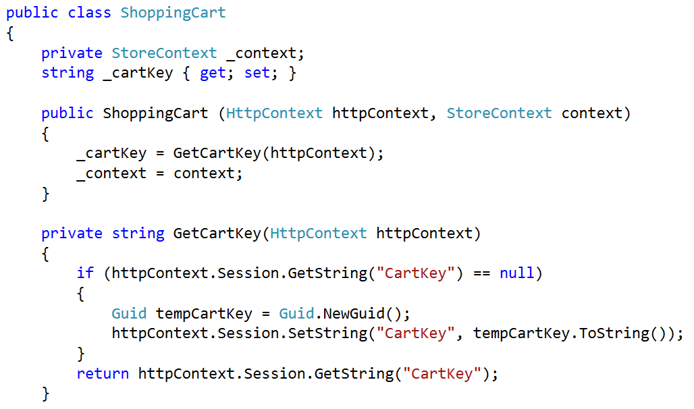
Business logic (ShoppingCart.cs)

Slide 32
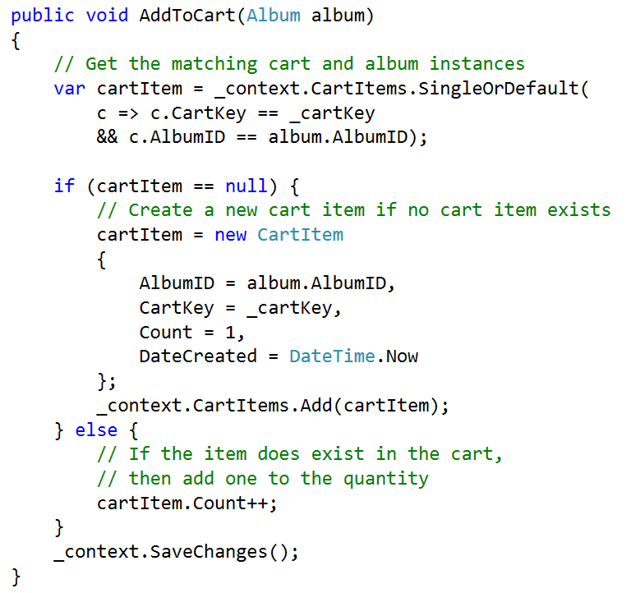
AddToCart
???
???
???

Slide 33
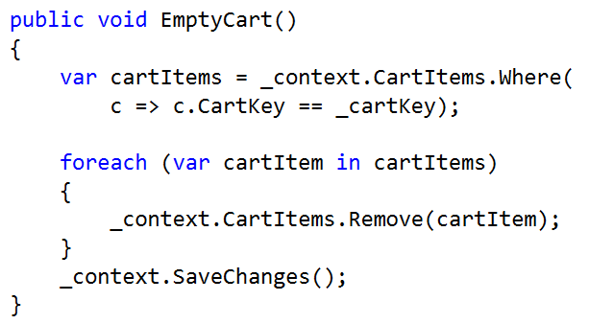
EmptyCart

Slide 34
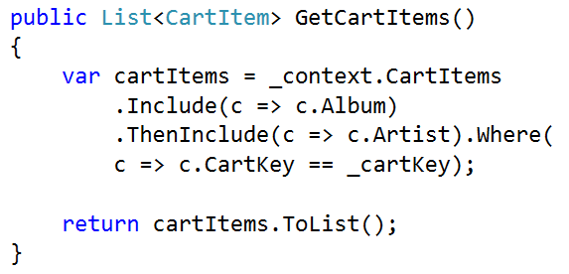
GetCartItems

Slide 35
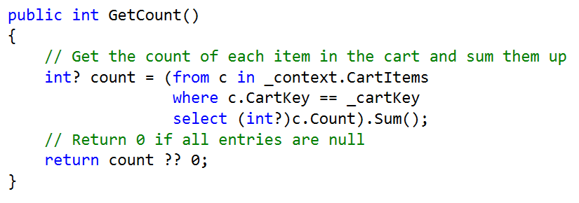
GetCount

Slide 36
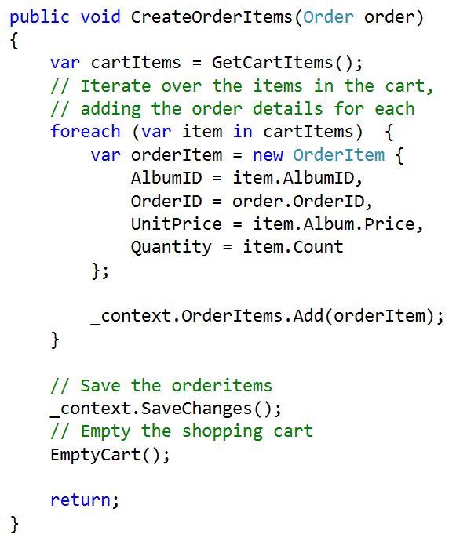
CreateOrderItems
???
???

Slide 37
Exercise
Music Store Part 3

